Slide 1
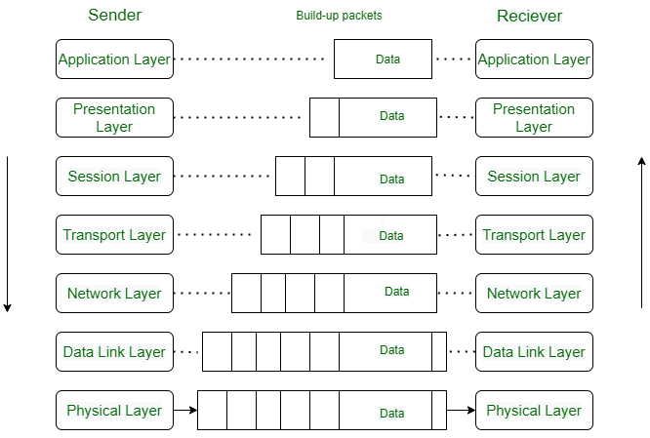
OSI Model Architecture

Slide 2
Layer 1 (physical layer)
The physical layer contains information in the form of bits. It is responsible for transmitting individual bits from one node to the next.
When receiving data, this layer will get the signal received and convert it into 0s and 1s and send them to the Data Link layer, which will put the frame back together.
Functions of physical layer:
Bit synchronization
Bit rate control
Physical topologies: Physical layer specifies how the different, devices/nodes are arranged in a network i.e. bus, star, or mesh topology etc.
Transmission mode: The various transmission modes possible are Simplex, half-duplex and full-duplex.
Note: Network Layer, Data Link Layer, and Physical Layer are also known as Lower Layers or Hardware Layers

Slide 3
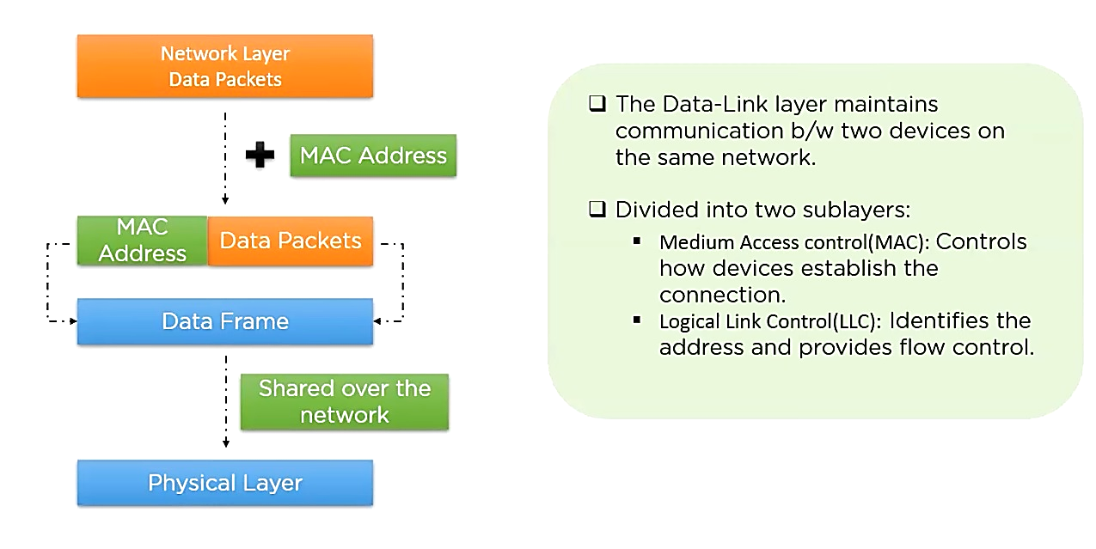
Data Link Layer
The LLC layer is responsible for error control and flow control. The error control function checks for error and retransmits the lost data and flow control maintains the constant data rate to control any error.

Slide 4
Network Layer
Functions of Network Layer:
Routing: The network layer protocols determine which route is suitable from source to destination. This function of the network layer is known as routing.
Logical addressing: The sender & receiver’s IP addresses are placed in the header by the network layer. Such an address distinguishes each device uniquely and universally.
Note: The network layer is implemented by networking devices such as routers.

Slide 5
Transport Layer
Functions of Transport Layer:
Segmentation and Reassembly: This layer accepts the message from the (session) layer, and breaks the message into smaller units. Each of the segments produced has a header associated with it. The transport layer at the destination station reassembles the message.
Service Point Addressing: To deliver the message to the correct process, the transport layer header includes a type of address called service point address or port address. Thus by specifying this address, the transport layer makes sure that the message is delivered to the correct process.
Note: The sender needs to know the port number associated with the receiver’s application.
The transport layer is also called the heart of the OSI model.

Slide 6
Session Layer
This layer is responsible for the establishment of connection, maintenance of sessions, and authentication, and also ensures security.
Session Establishment, Maintenance, and Termination: The layer allows the two processes to establish, use, and terminate a connection.
Synchronization: This layer allows a process to add checkpoints that are considered synchronization points in the data. These synchronization points help to identify the error so that the data is re-synchronized properly, and ends of the messages are not cut prematurely and data loss is avoided.
Dialog Controller: The session layer allows two systems to start communication with each other in half-duplex or full-duplex.
Note: All the below 3 layers(including Session Layer) are integrated as a single layer in the TCP/IP model as the “Application Layer”.

Slide 7
Presentation Layer
Functions of the Presentation Layer
Translation: For example, ASCII to EBCDIC
Encryption/ Decryption: Data encryption translates the data into another form or code. The encrypted data is known as the cipher text and the decrypted data is known as plain text. A key value is used for encrypting as well as decrypting data.
Compression: Reduces the number of bits that need to be transmitted on the network.

Slide 8
Application Layer
This layer is implemented by the network applications. These applications produce the data to be transferred over the network. This layer also serves as a window for the application services to access the network and for displaying the received information to the user.
Example: Browsers, Skype, Messenger, etc.
Functions:
Network Virtual Terminal(NVT): It allows a user to log on to a remote host.
File Transfer Access and Management(FTAM): This application allows a user to access files in a remote host, retrieve files in a remote host, and manage or control files from a remote computer.
Mail Services: Provide email service.
Directory Services: This application provides distributed database sources and access for global information about various objects and services.

Slide 9
The OSI model acts as a reference model and is not implemented on the Internet because of its late invention. The current model being used is the TCP/IP model.

